Slide 1
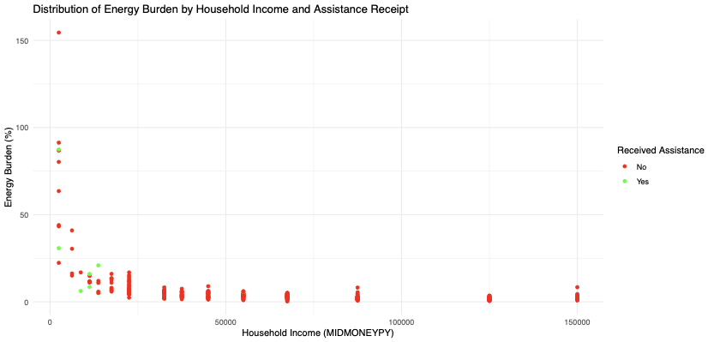
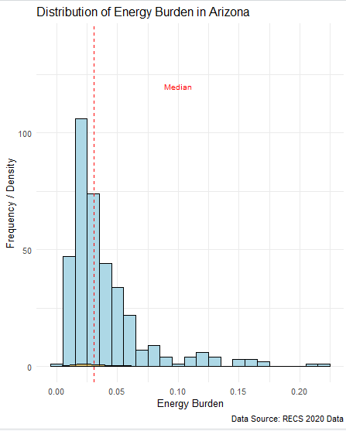


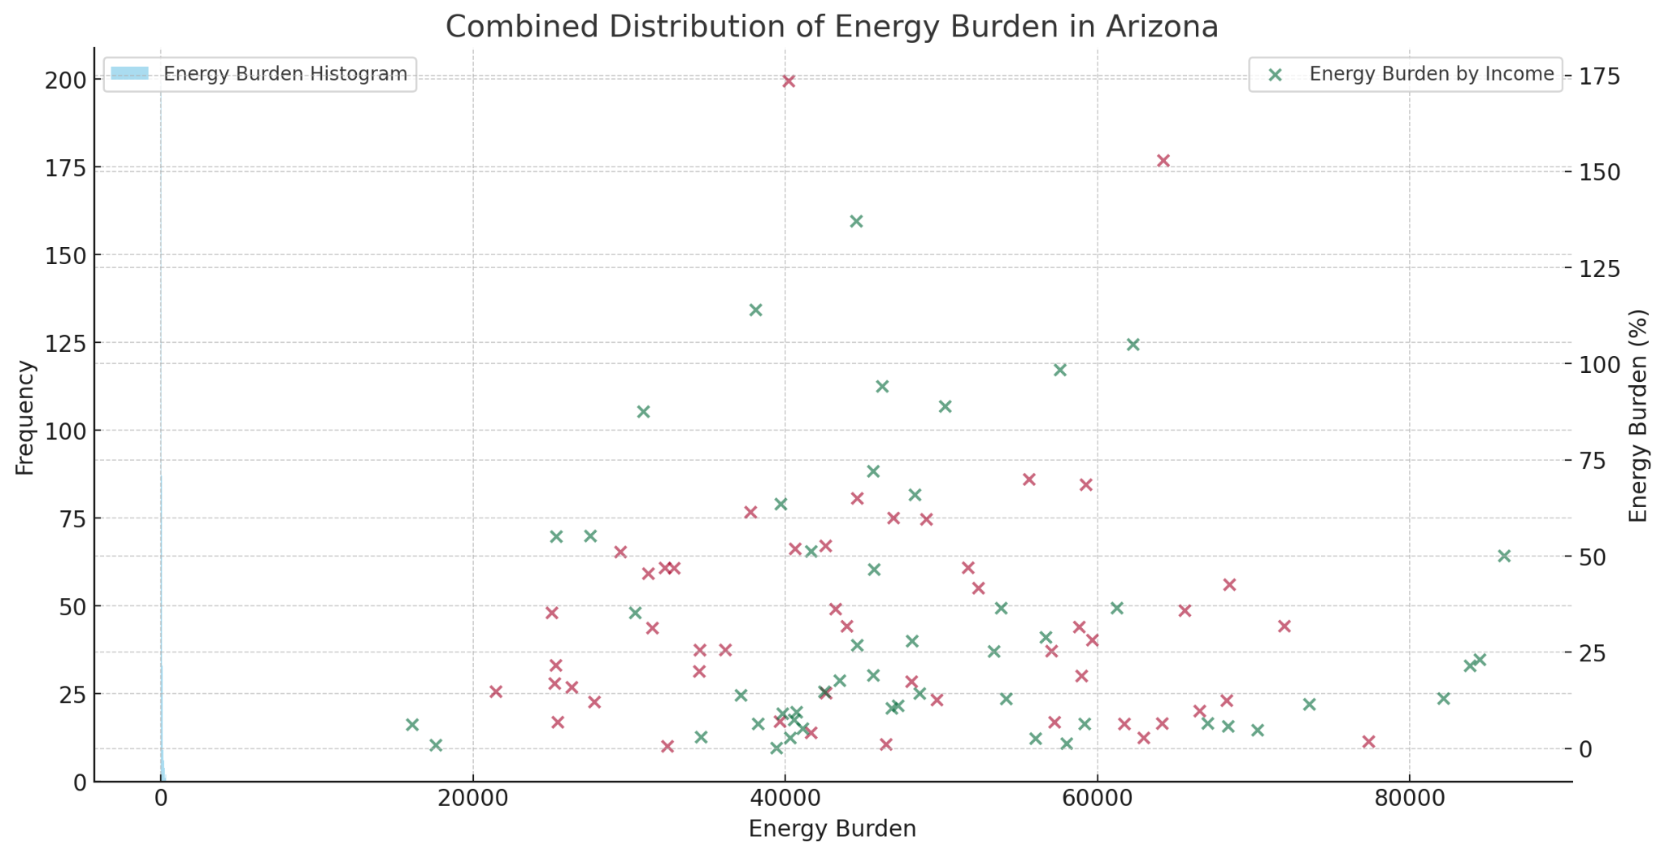
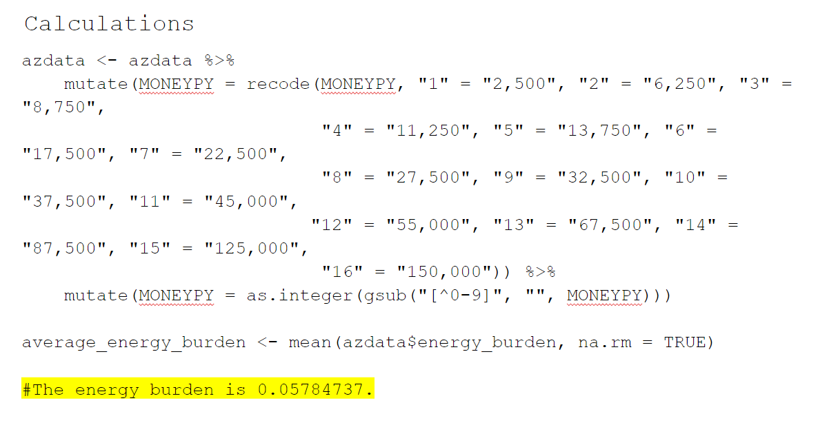
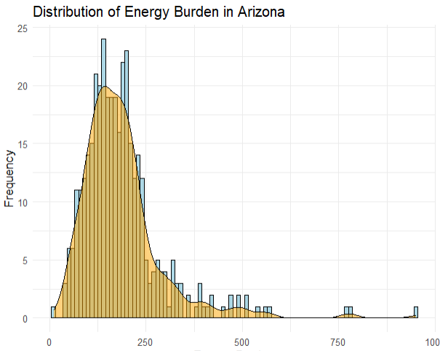
Residential Energy Consumption Data Analysis
Saif Elsaady, Data Science
Mentor: Clark Miller, Professor
The College of Liberal Arts and Sciences
How Can We analyze the RECS data to demonstrate variable connections?
Motivation
The motivation for analyzing the RECS data to demonstrate variable connections is to uncover intricate relationships and patterns within the data, enabling better understanding and informed decision-making in the relevant field.
Findings & Progress (so far)
The findings from the graphics suggest that the energy burden in Arizona is skewed towards lower values with the median energy burden falling within the lower quartile, indicating that a majority of households experience a relatively lower energy burden. The scatter plot further reveals a pattern where households with lower incomes and those receiving assistance exhibit a higher energy burden percentage, highlighting the economic impact on these groups.
Research Methods
1.) Data Mining in R.
2.) Regression with R.
Figure 1. Data Mining Analysis
Obstacles Faced
Obstacle | Overcoming Obstacle
Incomplete or missing data within the dataset | Implementing data imputation techniques using algorithms like k-NN or MICE to estimate missing values, ensuring a more complete dataset for analysis.
High dimensionality making it difficult to identify key variables | Applying dimensionality reduction techniques such as Principal Component Analysis (PCA) to extract the most significant features that influence the dataset.
Complex and non-linear relationships between variables | Utilizing advanced machine learning models such as Random Forests or Neural Networks that can capture nonlinear interactions better than traditional linear models.
Graphical Analysis
The graph in Figure 2. depicts the distribution of Arizona's energy load. A histogram with a density curve overlay is used to depict it. The bars of the histogram depict the frequency of energy burden values within specified ranges, whilst the density curve represents the distribution smoothed. The bulk of energy load values tend to be clustered in the lower range, with a peak around 100, implying that the majority of families have comparatively lower energy burdens. There are several outliers at the upper end, but these have been removed to provide a clearer picture of the center distribution. This graphic provides insights into the range and central trend of energy burden among Arizona families. The graph in Figure 3. represents a simulated combination of the energy burden distribution in Arizona. It includes a histogram showing the frequency of different energy burden values and a scatter plot that hypothetically maps energy burden against household income.
Figure 3. Combined Graphic
Conclusion
The conclusion drawn from the analysis of the RECS data indicates that the energy burden in Arizona predominantly affects those with lower incomes, especially those who do not receive assistance, with a significant portion of households experiencing a lower energy burden. This underscores the need for targeted policy interventions to alleviate the disproportionate energy expenditure burden on economically vulnerable populations.
Acknowledgements
I wish to show my appreciation to my mentor and professor Clark Miller for his support, and the SURF program for selecting me to conduct this research.
Figure 2. Energy Burden Distribution

